Slide 1
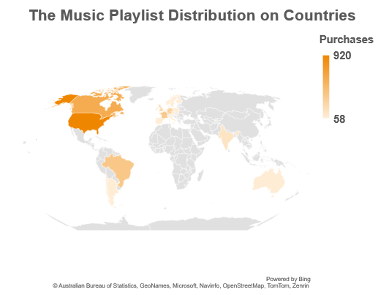
What are the most popular playlist type used in each country?
As you see on the left, These are amounts of playlist purchases in each country. The amount depends on the color degree from the dark to the pale color. Important to know, all these playlists are music playlist types. Therefore, the music playlist is the most popular type. Let us see an example, you can see the highest amount of music purchases are in the USA, because it has the darkest color against the rest countries.

Slide 2
Find out the most popular music Genre for each country.
As what you see, These are the maximum amounts of purchases of most popular music genres in each country. They are grouped in three categories, each category corresponding number of occurrences in the database.

Slide 3
Return all the track names that have a song length longer than the average song length.
As we see, the longer tracks are Occupation / Precipice then Through a Looking Glass, they exceed the 4,500,000 milliseconds. But the rest tracks even don’t close to them. In general, There are 494 tracks exceed the average song length from 3503 tracks. That means a little of tracks which over the average.

Slide 4
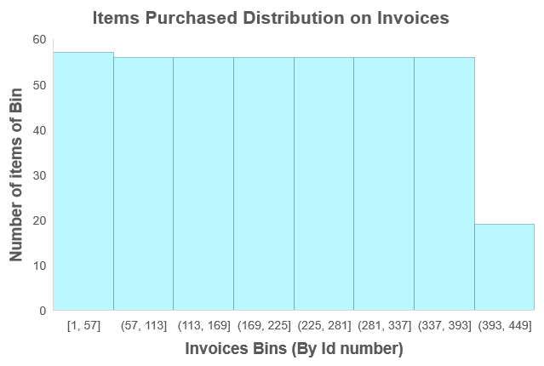
How many items did buy in each Invoice or Transactions?
AS you mentioned, the individual invoice is a transaction, that means it may have many items there. So, to investigate that, I was counting the items in each invoice. The maximum number of items is 14 in the invoice number 5. Let me tell you an important point, the invoices were grouped into bins what you are seeing on the left. So, the number of items in y-axis is the summation of the invoices in each bin.

